Slide 1

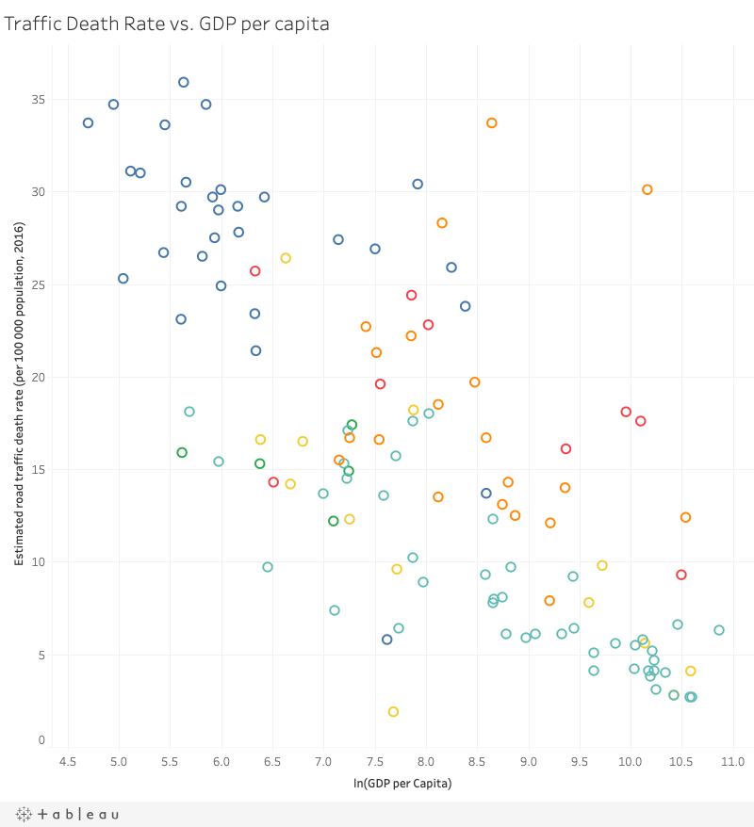
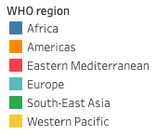
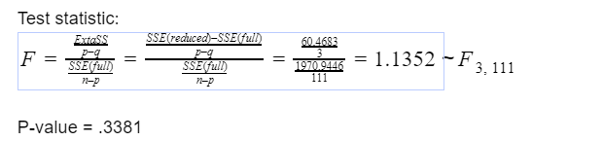
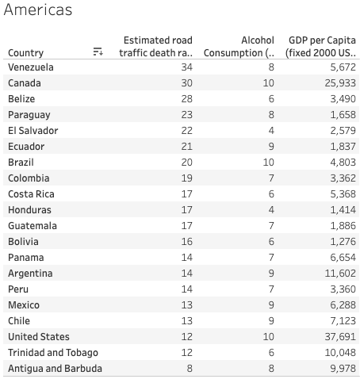
Exploring Traffic Death Rates Across Countries
Introduction:
Traffic deaths are a concern, not just for individuals in the United States, but for people in every country around the world. The question that we are trying to address is whether a relationship exists between various social and economic factors on the traffic death rate
Graph:
The Full Model:
trafficdeaths=36.0880 +1.508*ln(alc) -.2755*ln(vehicles) -.2131*ln(above60)-2.7876*ln(GDPpcap) +.0522*urbanpop+7.2045*Africa +4.8708*Mediterranean -7.2647*Europe -1.9296*Southeast Asia -5.3253*Western Pacific+
R-squared= .8154
Goodness of fit test:
Test:
H0:each i=0 (for i=alc, vehicle, …, Western Pacific)
Ha:at least one i0 (for i=alc, vehicle, …, Western Pacific)
Test statistic:
F=MSRMSE=870.564417.7563=49.0285~F10,111
p-value = P(F10,111>49.0285) = .0000
Reject the null hypothesis!
81.54% of the variability in traffic death rate is explained by our model.
At =.05, ln(vehicles), ln(above60), urbanpop, and Southeast Asia are not significant in explaining the traffic death rate. Consider dropping them from the model
The Reduced Model (p-value<alpha=.05):
trafficdeaths=33.00762+1.4666*ln(alc)-2.4433* ln(GDPpcap) +7.6485*Africa+6.1491*Mediterranean-7.3679*Europe -1.9296*Southeast Asia-5.0841* Western Pacific+
R-squared=.8032
Extra Sum of Squares Test:
Test:
H0:trafficdeaths=33.00762+1.4666*ln(alc)-2.4433*ln(GDPpcap)+7.6485*Africa +6.1491*Mediterranean-7.3679*Europe -1.9296*Southeast Asia-5.0841*Western Pacific+ (reduced model)
Ha:trafficdeaths=36.0880+1.508*ln(alc)-.2755*ln(vehicles)-.2131*ln(above60)-2.7876*ln(GDPpcap)+.0522*urbanpop+7.2045*Africa+4.8708*Mediterranean-7.2647*Europe-1.9296*Southeast Asia -5.3253*Western Pacific+(full model)
Fail to reject the null hypothesis. There isn’t enough statistical evidence to indicate the full model does a better job of explaining traffic death rate. Consequently, we will choose to use the reduced model.
Methodology:
Datasets used:
We selected what indicators to consider for our model based on our ideas of what factors we thought might relate to the traffic death rate. The indicators we chose to include initially for our full model are WHO region, alcohol consumption rate, motor vehicle rate, percentage of population above 60 years of age, GDP per capita, and urban population as a percentage of the total population. We gathered our traffic death rate data directly from the WHO, and we gathered the rest of our data from Gapminder, who aggregated data from multiple sources such as the World Bank, UN, and WHO.
Method:
We used multiple regression to answer our question. We began by creating a graph matrix of our variables to determine if there were any problems with the data that we needed to address. After examining our matrix we saw that there was not a linear relationship between the explanatory variables, alc, gdp, and above60 and our response variable of trafficdeaths. To address this, we used the natural log transformation to transform that data and determined that the data was more linear after our transformation. After transforming our data, we regressed all of the explanatory variables onto our response variable, trafficdeaths. We checked our residuals using a residual vs. fitted value plot to examine our data for outliers and from this, saw no significant outliers. We then examined our regression and looked at the p-values of each of our explanatory variables to assess if there were any that were unnecessary. We tested the p-values at an alpha of .05 and therefore removed lnvehicles, lnabove60, and urbanpop from our model because they had p-values of greater than .05. We then regressed our reduced fit model
Result:
We could see form the graph earlier all the regions have less traffic death as the GDP of the country is increase . Also we found out that the number vehicles on road have no relation with the traffic death. Another thing that we found out was that the Canada was outlier in its region of America Which might be reason (along with Venezuela )That the Americas Region as a total have less slope and is almost straight line.
Future:
By: Parker Brotman, Riyo, Sabrina, Samriddh Gupta

